Slide 1

Green University of Bangladesh
Department of Computer Science and Engineering (CSE)
Faculty of Sciences and Engineering Semester: Summer, 2022, B.Sc. in CSE (DAY)
Data Structure Lab
Course Code: CSE 106
Section: CSE 213 - DA (PC)
Project Title:
GUB STUDENT REPORT CARD
Student Details
Name | ID
Md. Shahidul Islam Prodhan | 213902017
Submission Date: 11th September, 2022
Course Teacher’s Name: Farhana Akhtar Sunny, Senior Lecturer
[For Teacher’s use only: Don’t write anything inside this box]
Lab Report Status
 | Marks: | Signature:
 | Comments: | Date:

Slide 2
Table of Contents
Chapter 1 Introduction ...................................................................................................................................3
1.1 Introduction...............................................................................................................................................3
1.2 Design Goals/Objective ............................................................................................................................3
Chapter 2 Design/Development/Implementation of the Project..................................................................4
2.1 Interface ...................................................................................................................................................4
2.2 Implementation..........................................................................................................................................5
Chapter 3 Performance Evaluation .............................................................................................................10
3.1 Simulation Environment/ Simulation Procedure.....................................................................................11
3.2 Analysis and Outcome .........................................................................................................................12
Chapter 4 Conclusion ....................................................................................................................................15
4.1 Introduction.............................................................................................................................................15
4.1 Practical Implications .............................................................................................................................15
4.2 Scope of Future Work.............................................................................................................................15
2 | P a g e

Slide 3
Chapter 1
Introduction
Introduction
GUB Student Report Card is a software solution for tracking and having a glance at a student’s academic performance and result is specifically designed for educational instituitions, and its many features enable institution’s efficient functioning on a daily basis. The computerization of the student result according to each semester will improve the efficiency and reduce human stress, and also indirectly improve the human recourses. This system helps the user to show subject-wise results and the percentage of students.
Design Goals/Objective
The main focus of this project is to reduce time and lessen human efforts.
To provide a user-friendly environment where a user can be serviced better easy.
To gathers all the valuable student-related mark information on a single platform, enables quick retrieval of essential data, and filters their availability by the access level.
To replace a complex net of educational bureaucracy and provide efficient communication channels on all levels.
To keep all the mark related information organized and show them in a batter place, and reduce the chance of mistake.
3 | P a g e

Slide 4
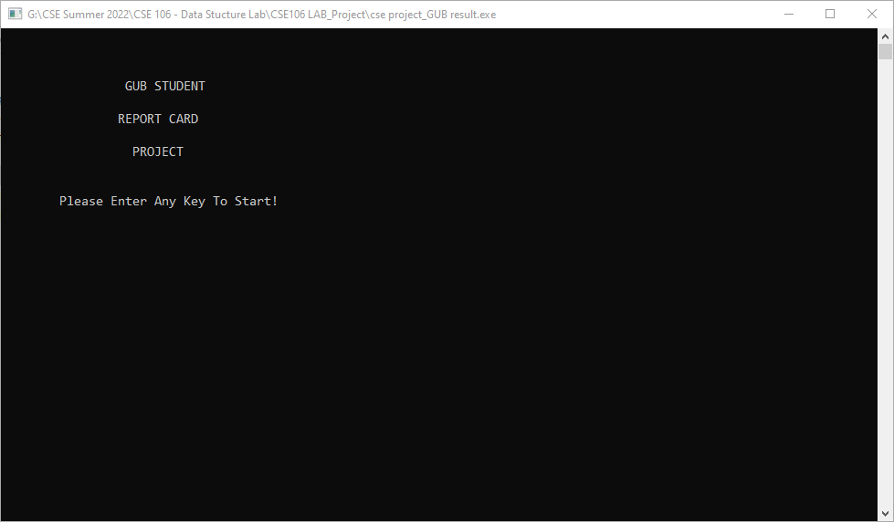
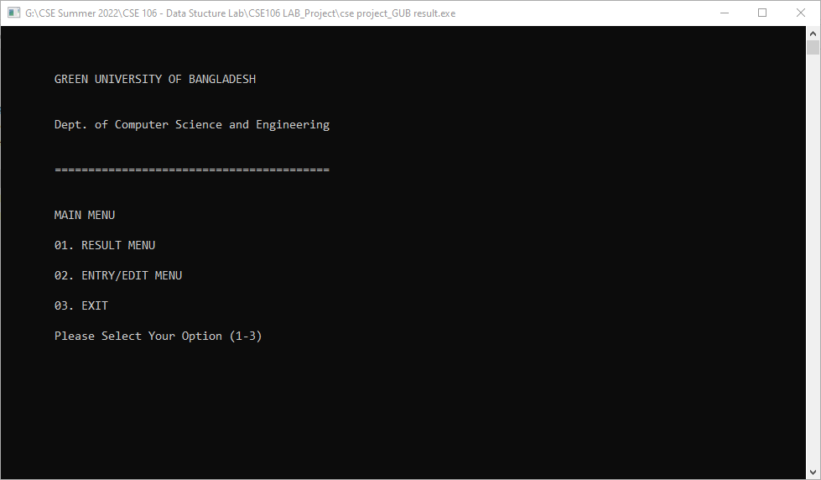
Chapter 2
Student Record System Design
GUB Student Report Card System I made using C program will be look like this.
Interface
4 | P a g e

Slide 5
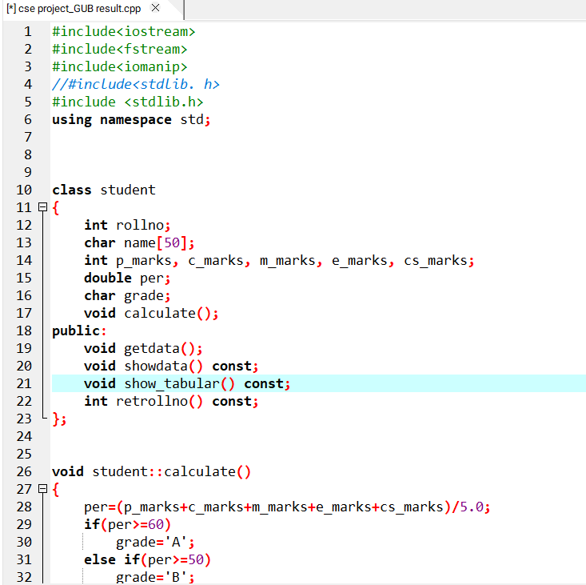
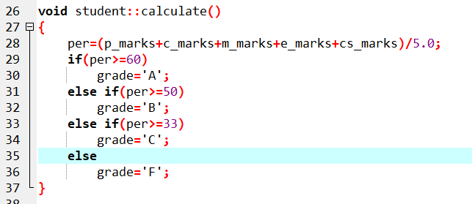
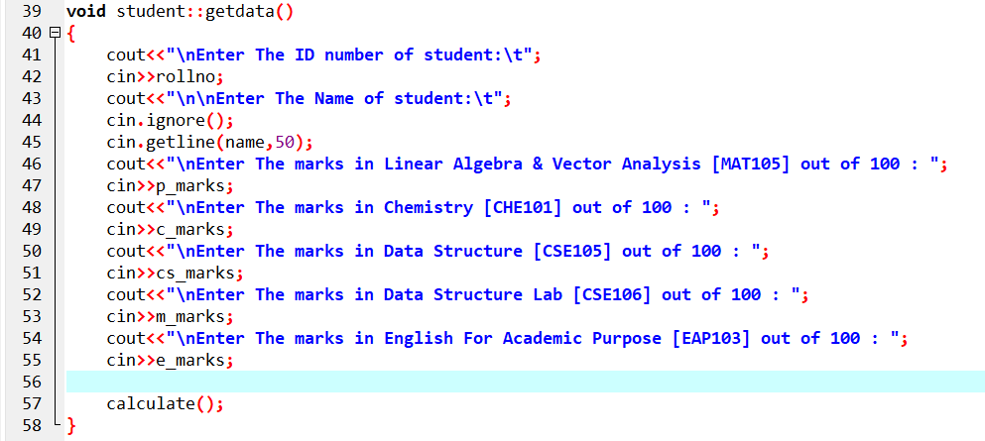
Implementation of the Project:
Start of the code:
void student::calculate()
this will calculate the data
void student::getdata()
this will get the data of the students from the user
5 | P a g e

Slide 6
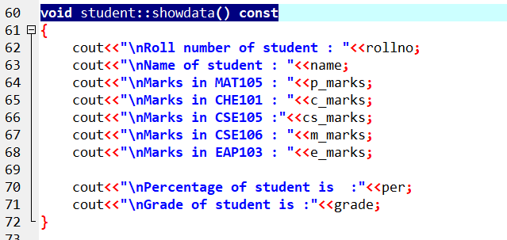
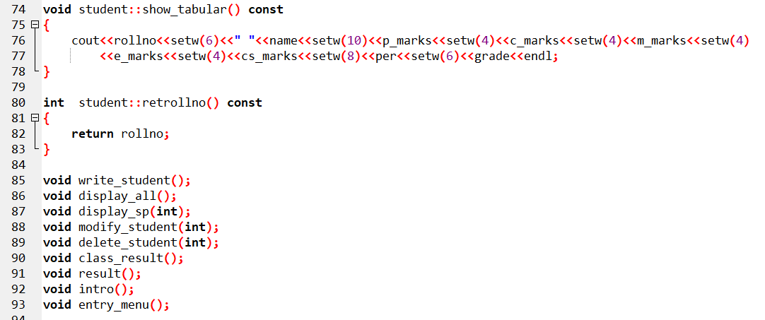
void student::showdata() const
This function is used for showing data.

Slide 7
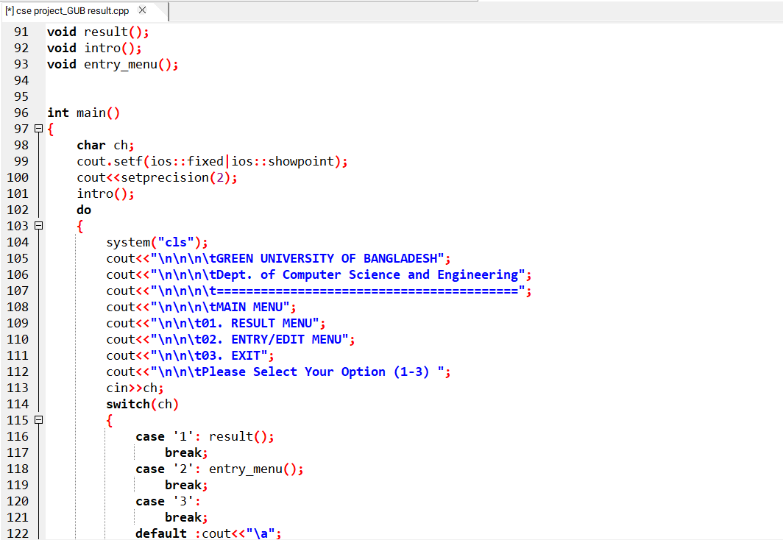
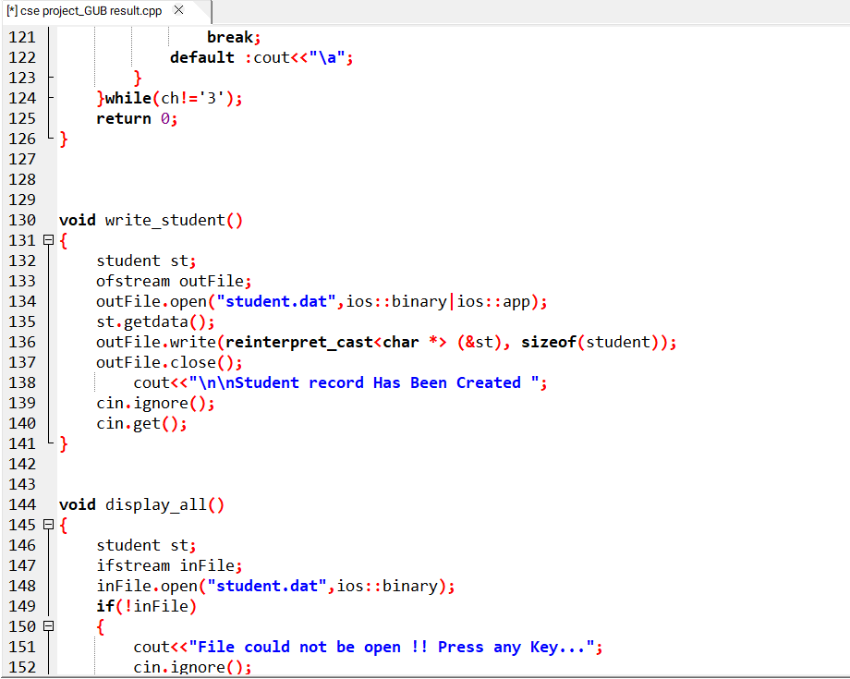
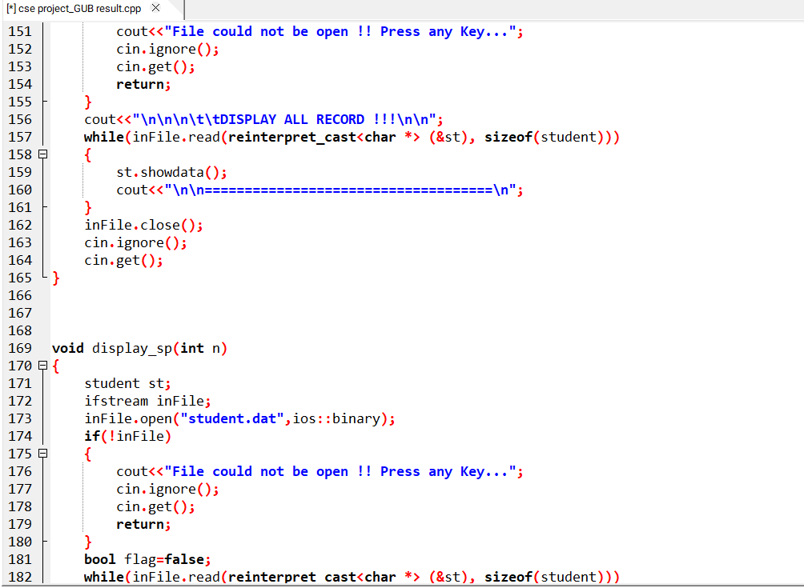

Slide 8
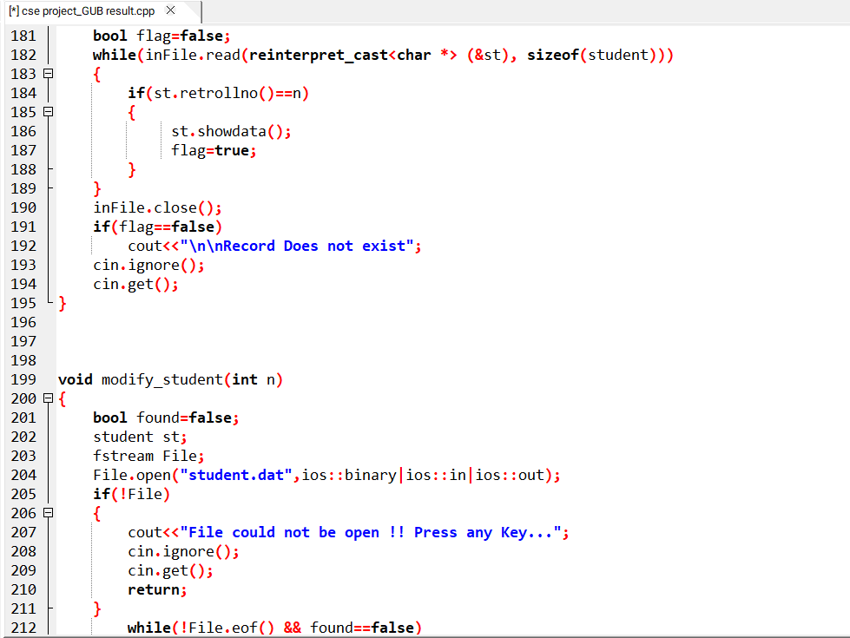
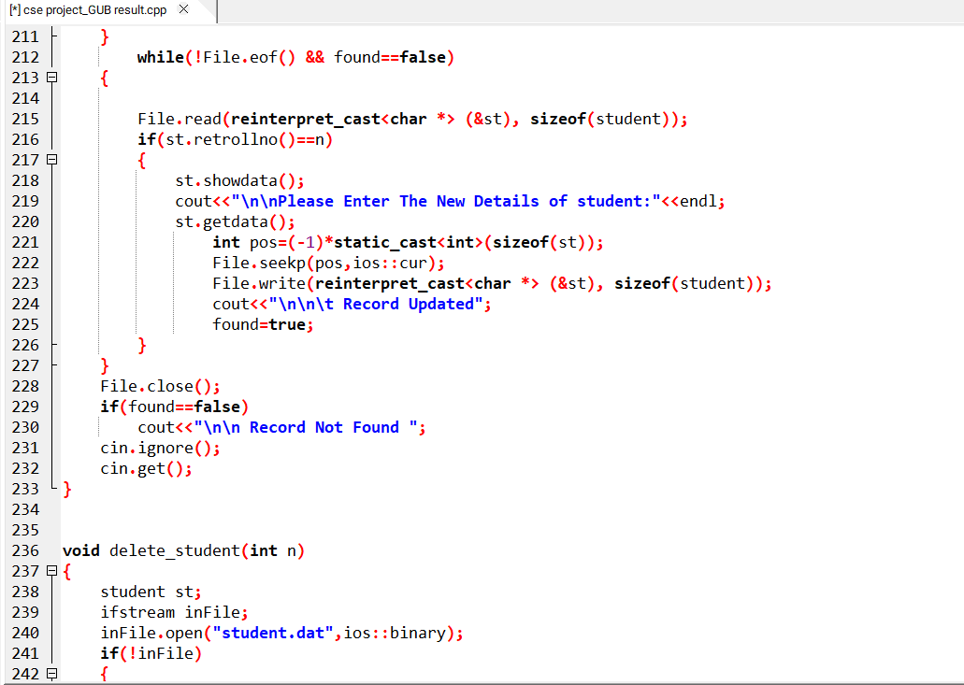
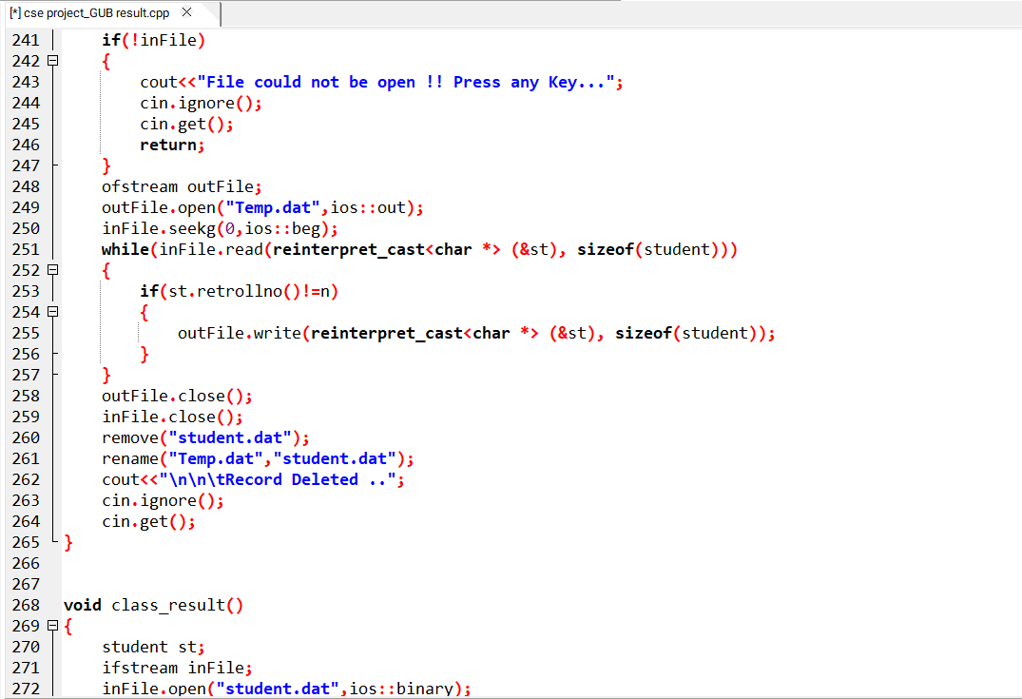

Slide 9
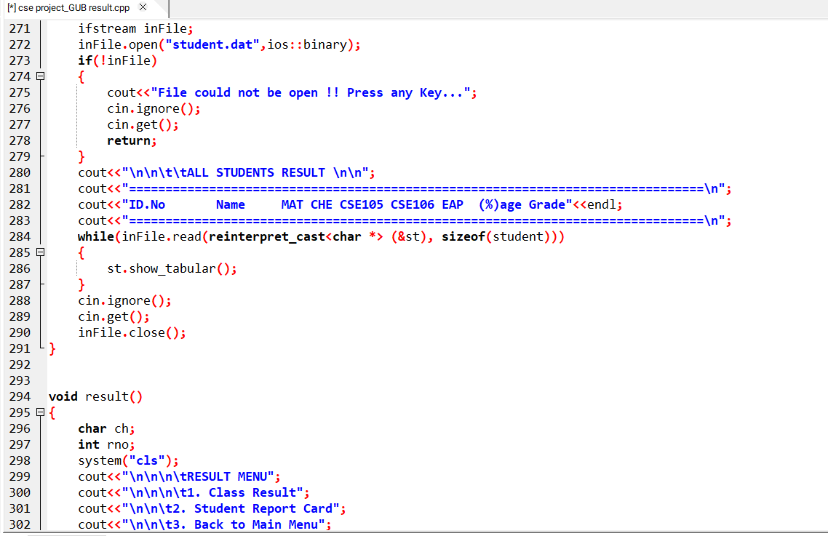
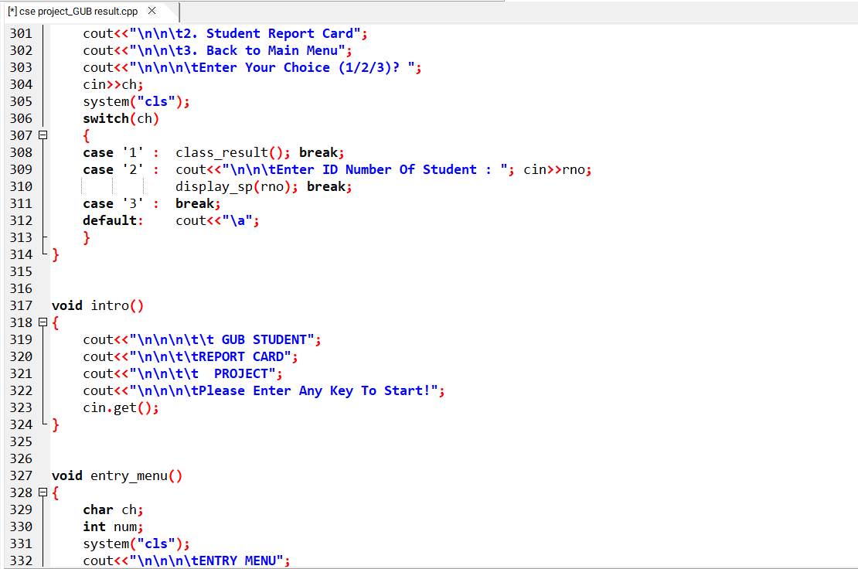
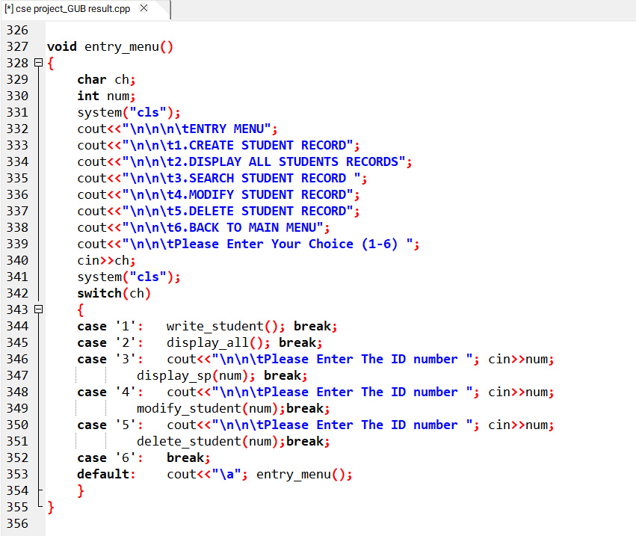

Slide 10
Chapter 3
Performance Evaluation
Results and Discussions
Output
This is the main panel of the system. From here the software will take user input.

Slide 11
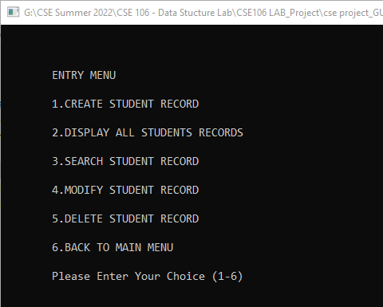
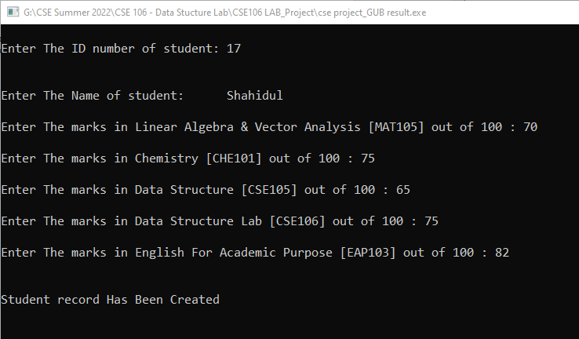
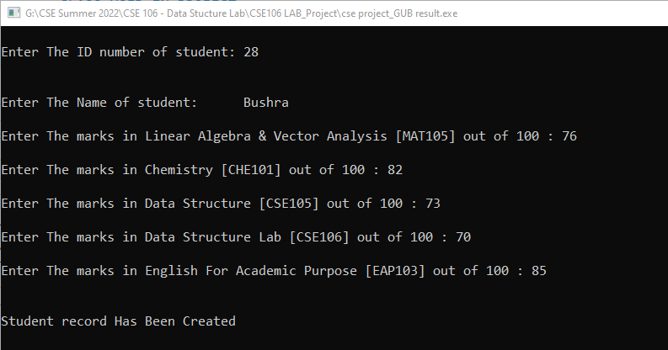

Slide 12
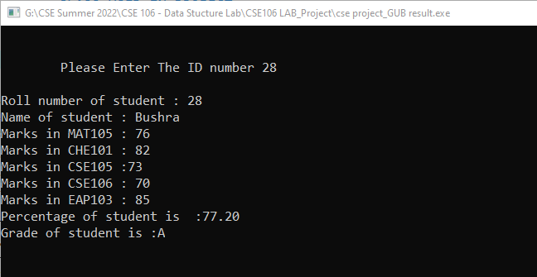
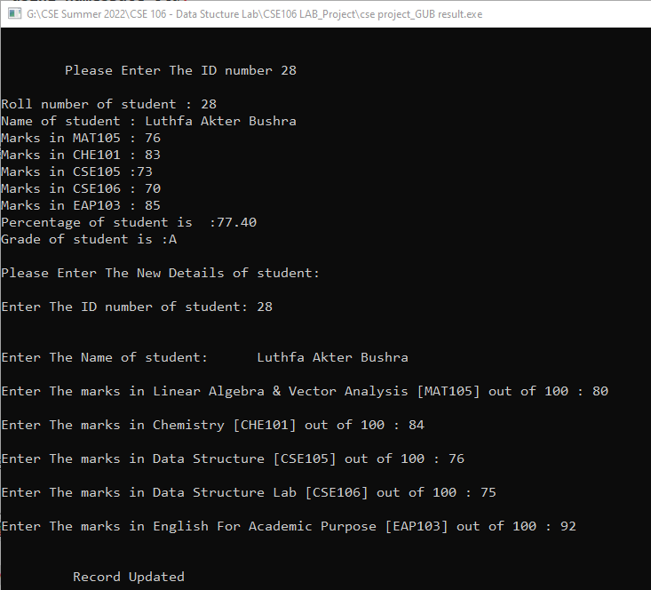
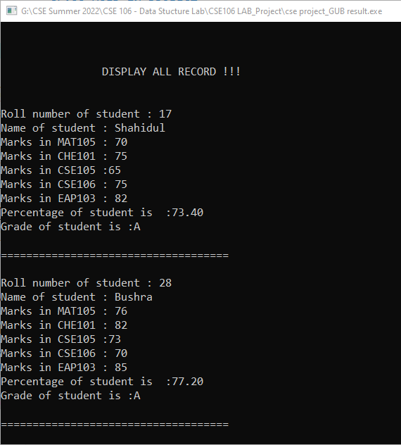

Slide 13
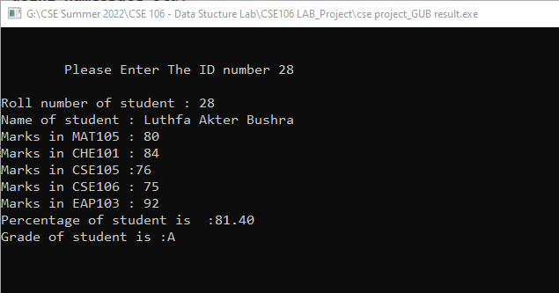
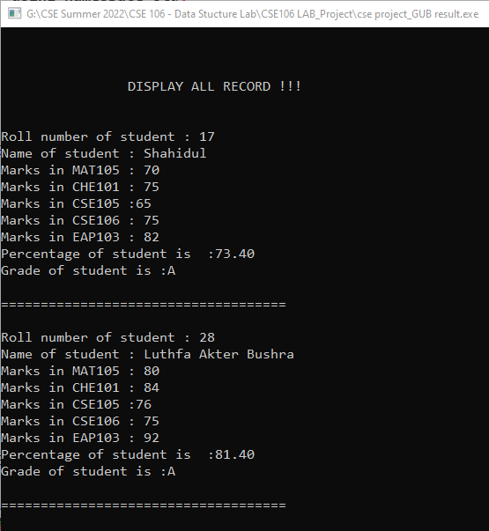
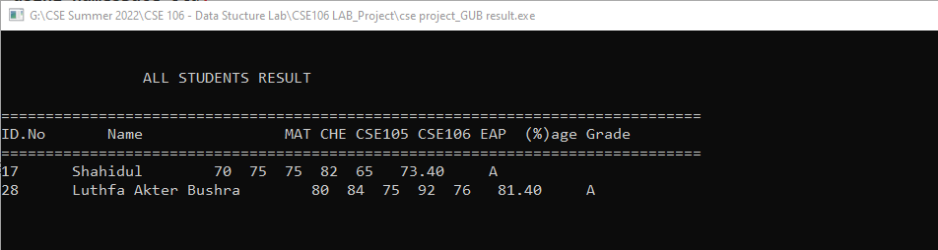

Slide 14
3.2 Analysis and Outcome
The project is build using C programming language. We do the coding on DevC++ using GCC compiler. This project is mainly built for reduce the pressure and do the work efficiently. We will update this project and add more feature. It will be helpful for all the students and the teachers. So we do the project using the course knowledge of Data Structure.

Slide 15
Chapter 4
Conclusion
4.1 Introduction
GUB Student Report Card System to be computerized to reduce human errors and to increase efficiency. By computerized the system we can do the work lesser errors. This project is built for calculate a students subject wise mark and showing marksheet. And track the result information quickly.
Practical Implications
GUB Student Report Card System helps the educational institutions to publishing and grading result of the students.
Scope of Future Work
In future this can be the most useful product in the school, college and university. It will keep the student’s information safe and synchronized. In future we can add more feature to this.
Like add average results of a student, billing history of a student, attendance of a student. This system can reduce the mistake and work more efficiently. In this way it can be helpful for our work.

